Slide 1

IBM HR Analytics
for
Employee Attrition and Performance Prediction
Presented by -
Deepak Yadav

Slide 2

Introduction
Objective
Motivation
System Architecture
Methodology
Dataset Info
Implementation
Conclusion
References

Slide 3

Introduction
HR analytics is the process of collecting and analyzing Human Resource (HR) data in order to improve an organization’s workforce performance. The process can also be referred to as talent analytics, people analytics, or even workforce analytics.
This method of data analysis takes data that is routinely collected by HR and correlates it to HR and organizational objectives. Doing so provides measured evidence of how HR initiatives are contributing to the organization’s goals and strategies.

Slide 4

OBJECTIVE
Employee attrition is the rate at which employees leave a company. The goal of this analysis is to model employee attrition and determine the most dominant contributing factors that govern this turnover. Through this kind of analysis, we can understand how many employees are likely to leave, while also determining which employees are at the highest risk and for what reasons.

Slide 5

MOTIVATION
The project stems from the potential to improve employee satisfaction, reduce costs, enhance organizational performance, and create a positive workplace culture. It's an opportunity to use data and analytics to make meaningful changes that benefit both employees and the organization as a whole.

Slide 6
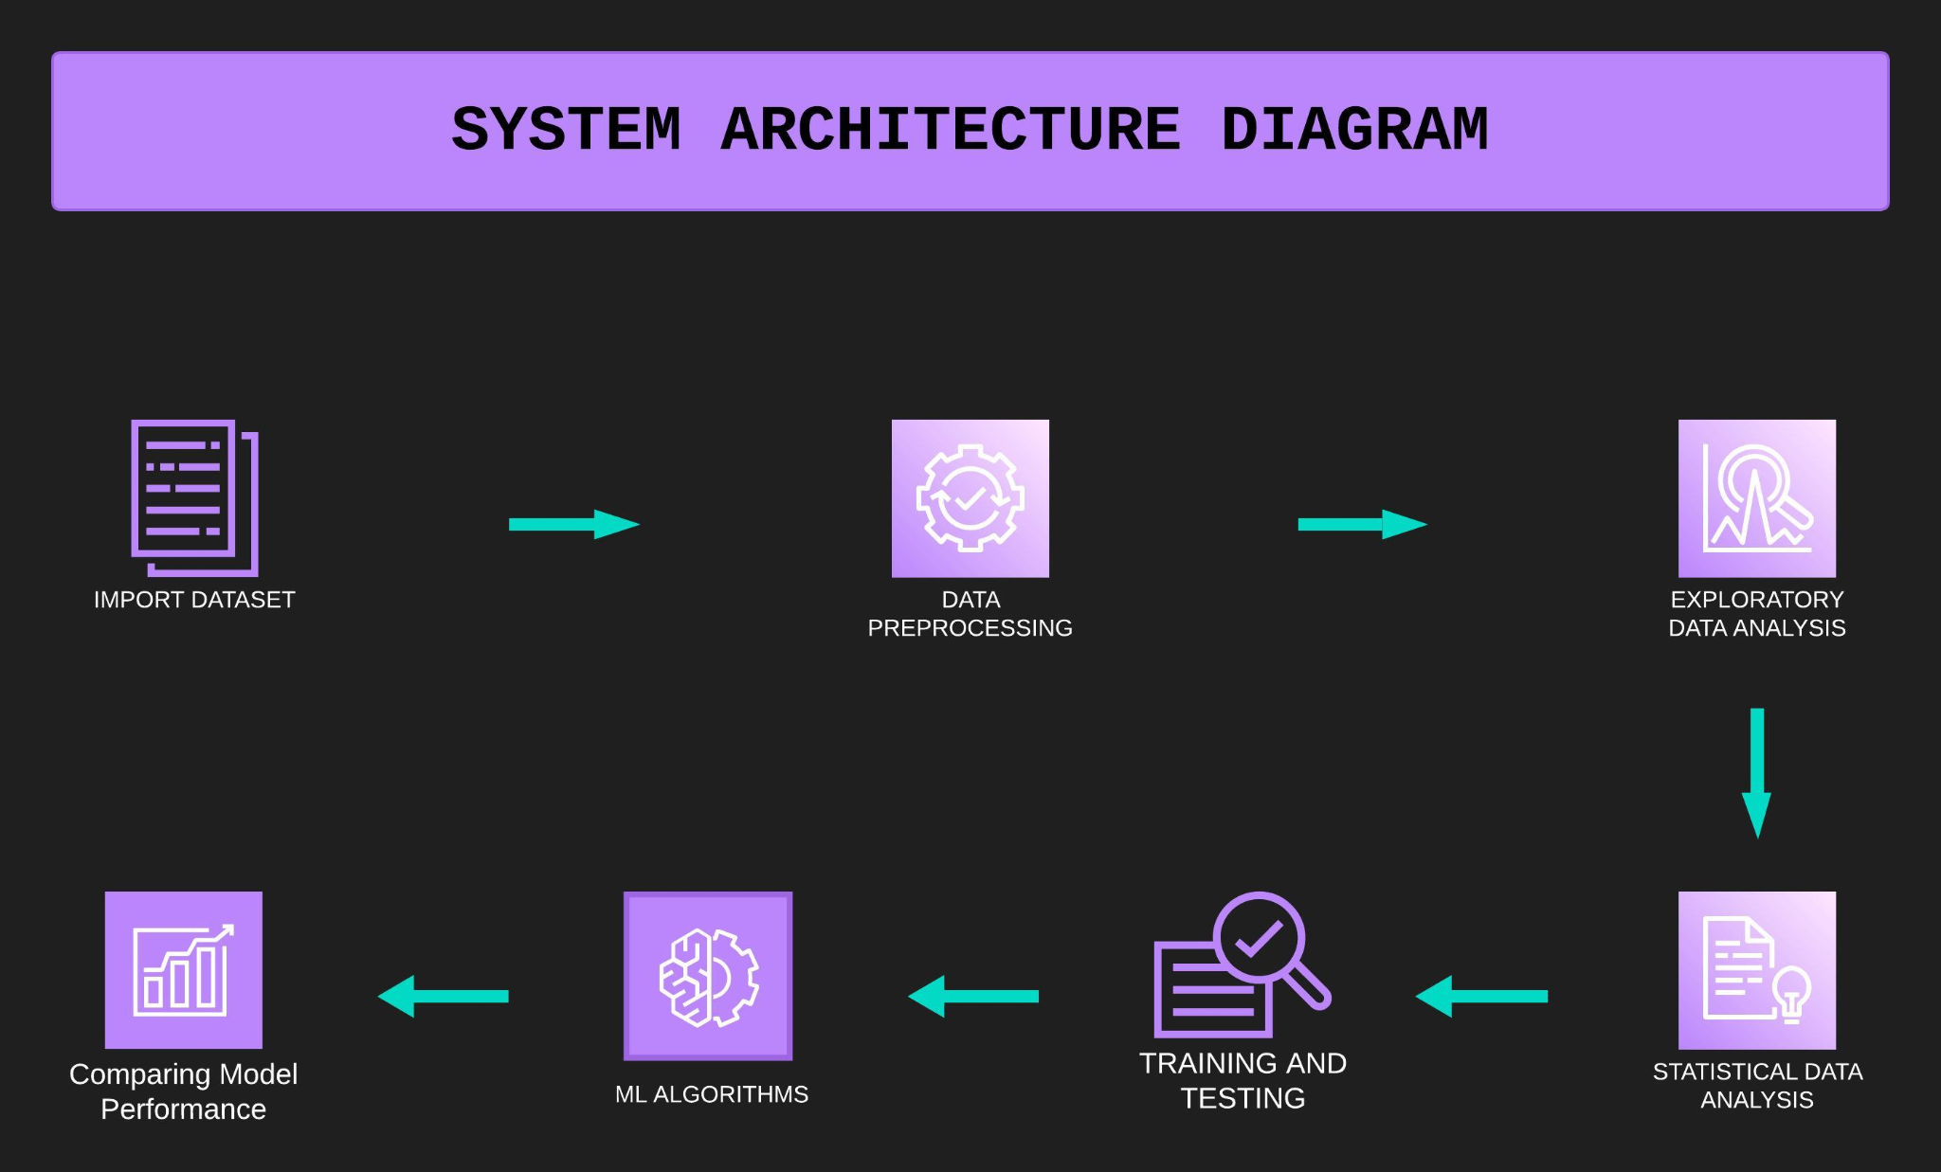

Slide 7
METHODOLOGY
- Load the Dataset: The IBM HR Analytics Attrition Dataset is loaded using the pd.read_csv() function. The head() and info() methods are used to display the first few rows and get information about the dataset, respectively.
- Knowing the Dataset: Basic Information about the dataset is generated; numerical and categorical attributes are enlisted.
- Data Cleaning: Any missing values in the dataset are dropped using the dropna() method.
- Data Visualization: Matplotlib and Seaborn libraries are used to visualize the data.
- Statistical Analysis: The ANOVA Test is performed to analyze the Numerical Features' Importance in Employee Attrition, while the Chi-Square Test to Analyze the Categorical Feature Importance in Employee Attrition.
- Data Preprocessing: The target variable 'Attrition' is mapped to binary values (1 for 'Yes' and 0 for 'No'). Selected features are extracted from the dataset and one-hot encoded using the get_dummies() function.
- Splitting the Dataset: The dataset is split into training and testing sets using the train_test_split() method from scikit-learn.
- Implementing Machine Learning Algorithms: Logistic Regression, XGBoost, CatBoost, AdaBoost, LightGBM, Decision Tree, and Random Forest classifiers are initialized and trained using the training data.
- Model Evaluation: The accuracy score and confusion matrix are computed to evaluate the performance of each algorithm on the testing data.
- Results: The results, including the accuracy and confusion matrix, are printed for each algorithm.
- Model Performance Comparison: The hvPlot library is used to visualize the ROC curve diagram comparing the performance of all models used.

Slide 8
DATASET
This is a hypothetical dataset created by IBM data scientists. The dataset has (1470R X 35C) that contains numeric and categorical data types describing each employee’s background and characteristics, and labeled with whether they are still in the company or whether they have gone to work somewhere else.
01] Age
02] Attrition
03] BusinessTravel
04] DailyRate
05] Department
06] DistanceFromHome
07] Education
08] EducationField
09] EmployeeCount
10] EmployeeNumber
11] EnvironmentSatisfaction
12] Gender
13] HourlyRate
14] JobInvolvement
15] JobLevel
16] JobRole
17] JobSatisfaction
18] MaritalStatus
19] MonthlyIncome
20] MonthlyRate
21] NumCompaniesWorked
22] Over18
23] OverTime
24] PercentSalaryHike
25] PerformanceRating
26] RelationshipSatisfaction
27] StandardHours
28] StockOptionLevel
29] TotalWorkingYears
30] TrainingTimesLastYear
31] WorkLifeBalance
32] YearsAtCompany
33] YearsInCurrentRole
34] YearsSinceLastPromotion
35] YearsWithCurrManager

Slide 9
IMPLEMENTATION

Slide 10
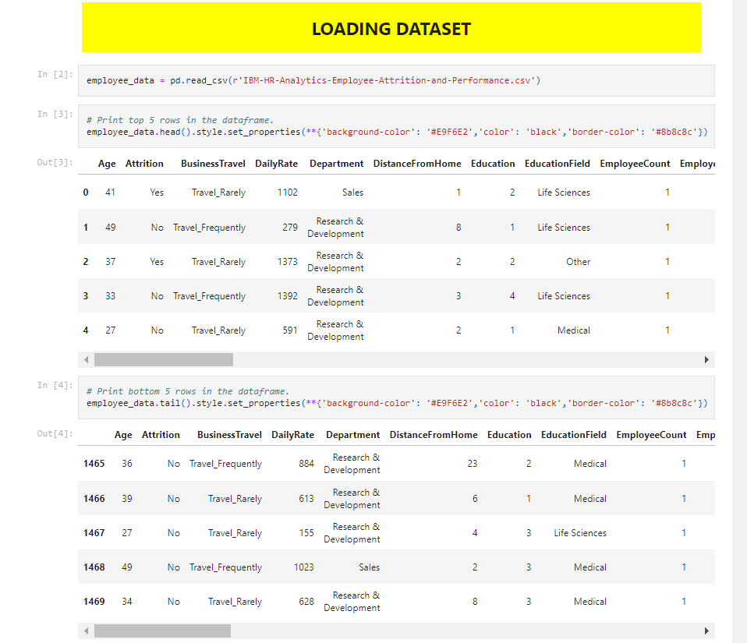
IMPLEMENTATION
ABOUT DATASET

Slide 11
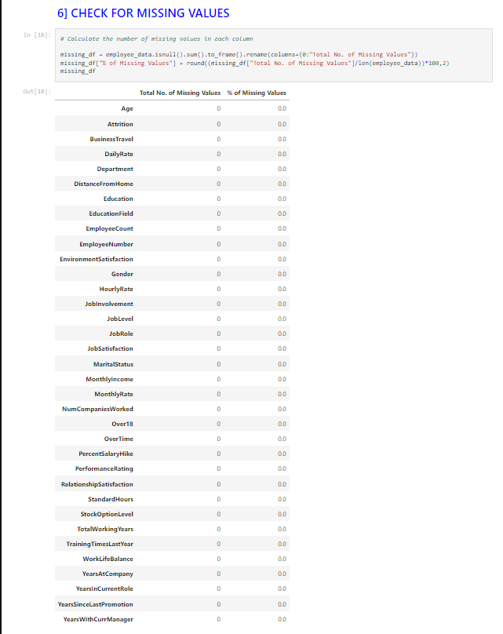
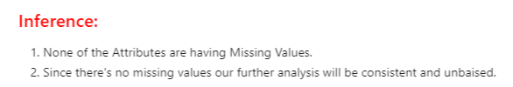
CHECK FOR MISSING VALUES

Slide 12
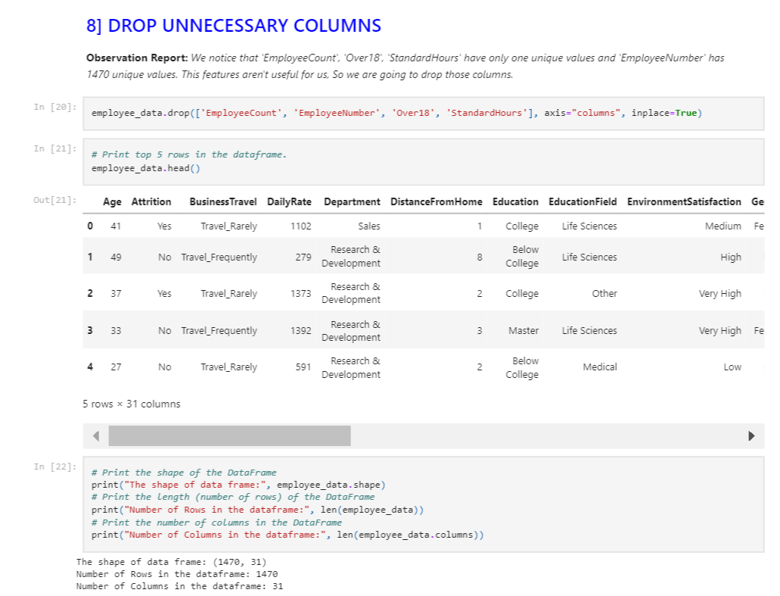
DROP UNNECESSARY VALUES

Slide 13

Predictive Insights for Employee Attrition
By analyzing employee data, we can identify factors that contribute to employee attrition, such as job satisfaction, compensation, and work-life balance. This information can be used to develop strategies to retain top talent and reduce turnover rates.

Slide 14

Identifying High-Performing Employees
HR analytics can help identify high- performing employees by analyzing data related to performance metrics, such as productivity, quality, and customer satisfaction. This information can be used to develop strategies to retain top talent and improve overall organizational performance.

Slide 15
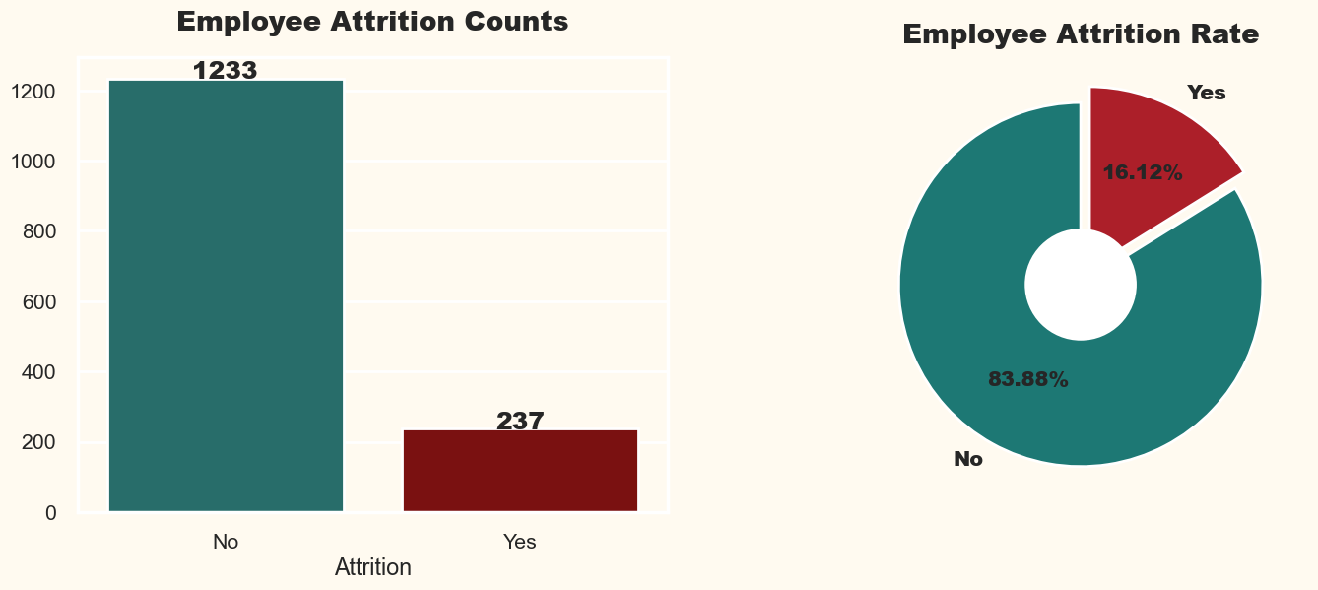
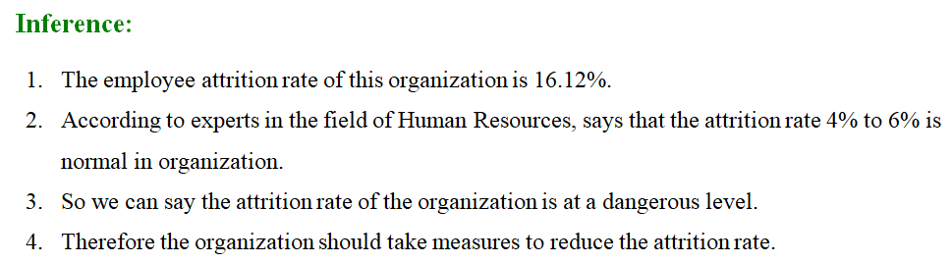
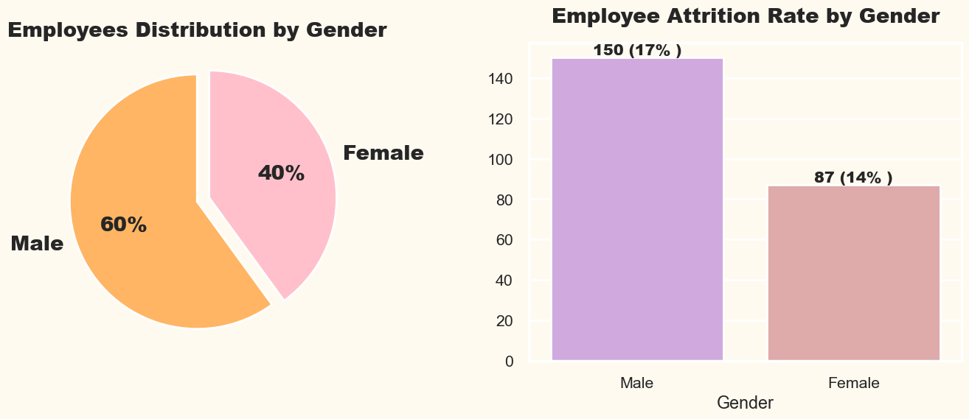
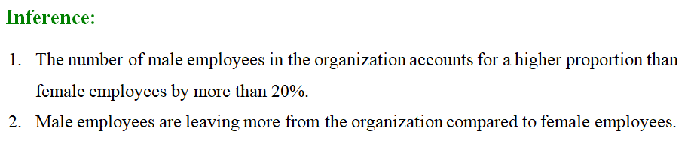

Slide 16
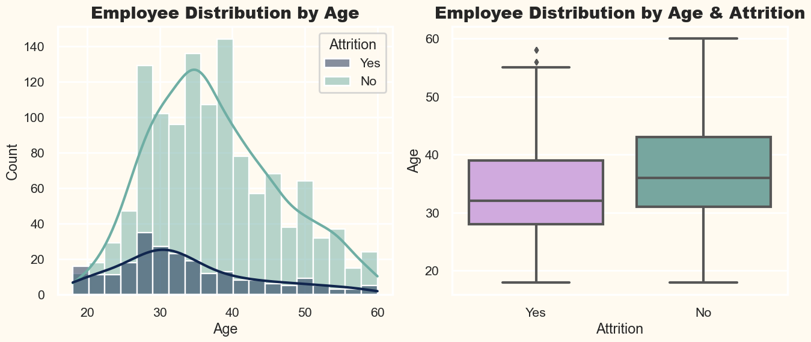
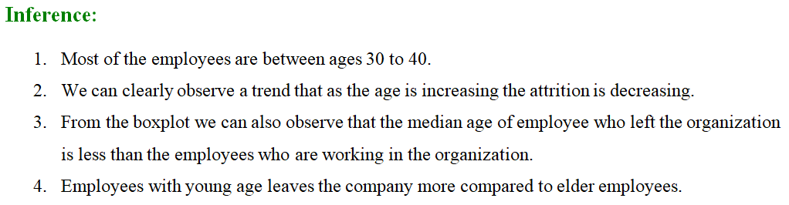
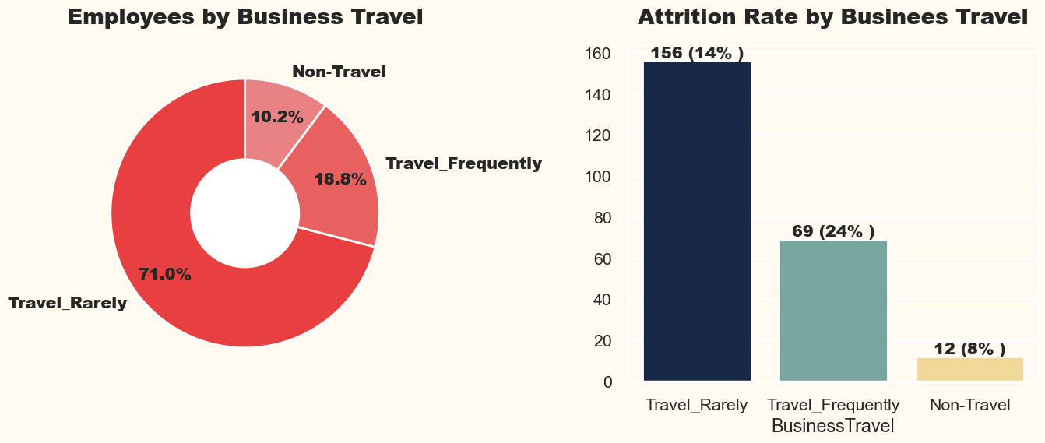
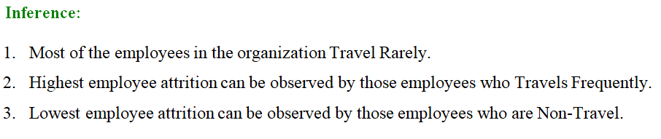

Slide 17
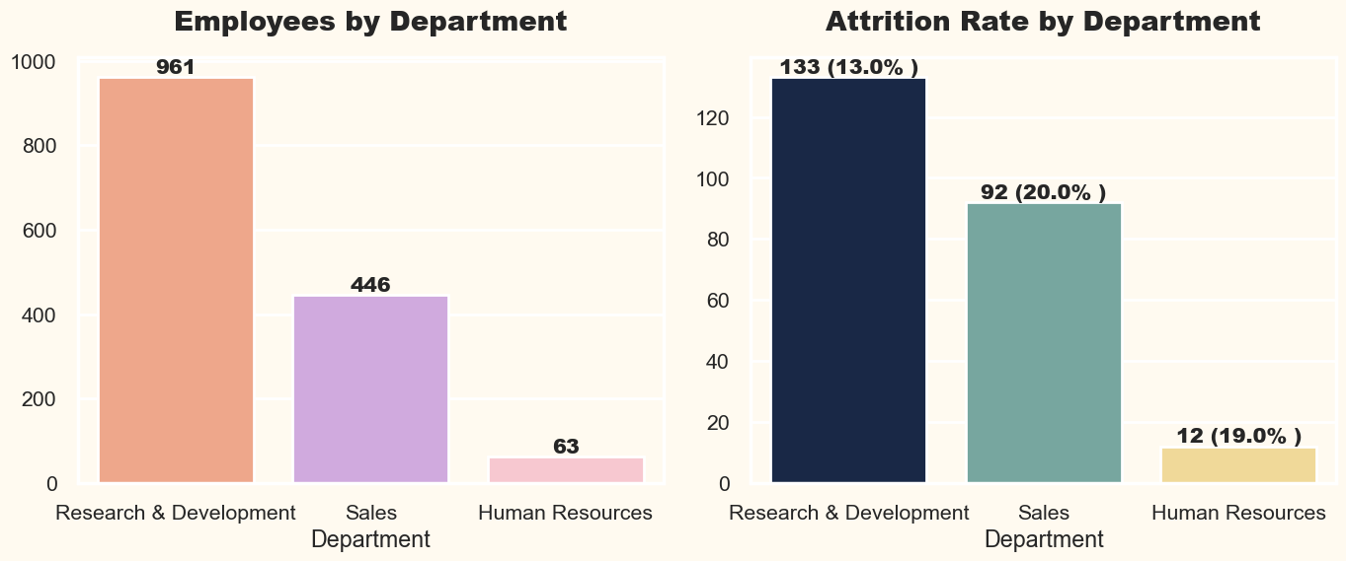
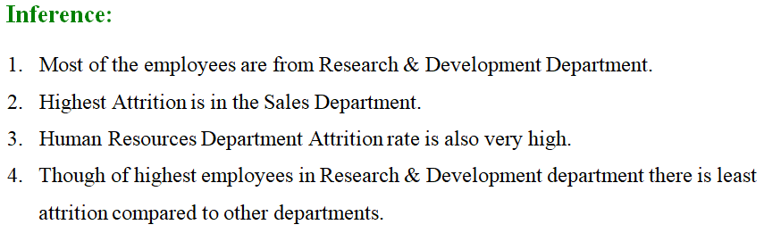
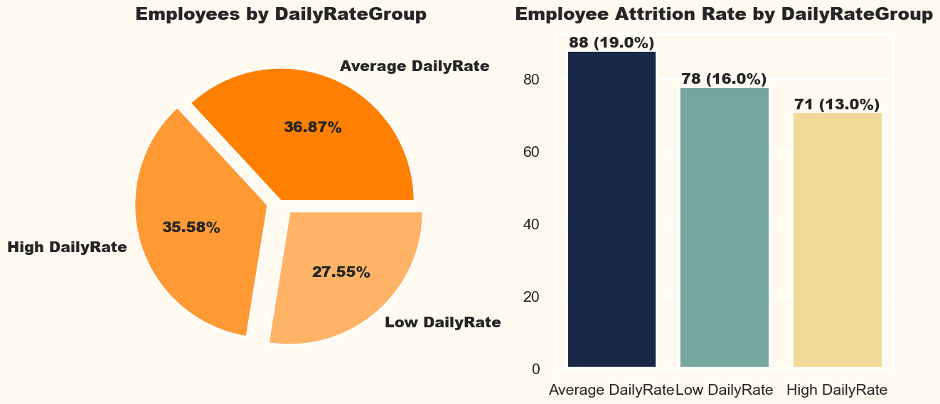
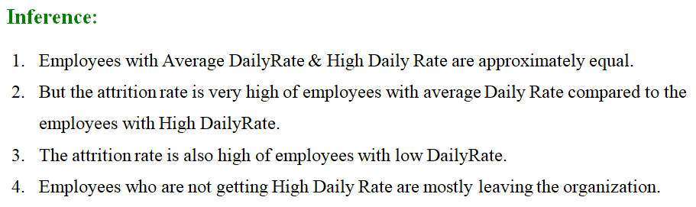

Slide 18
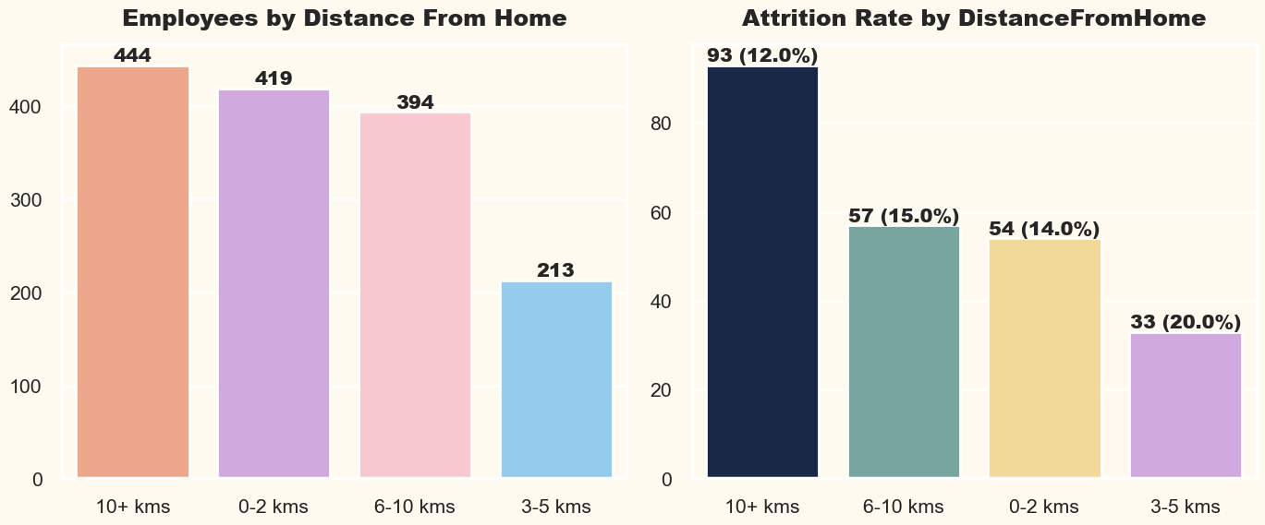
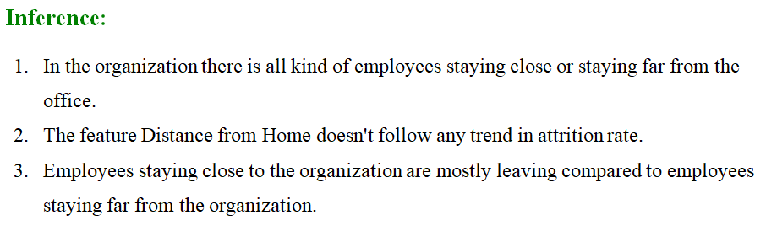
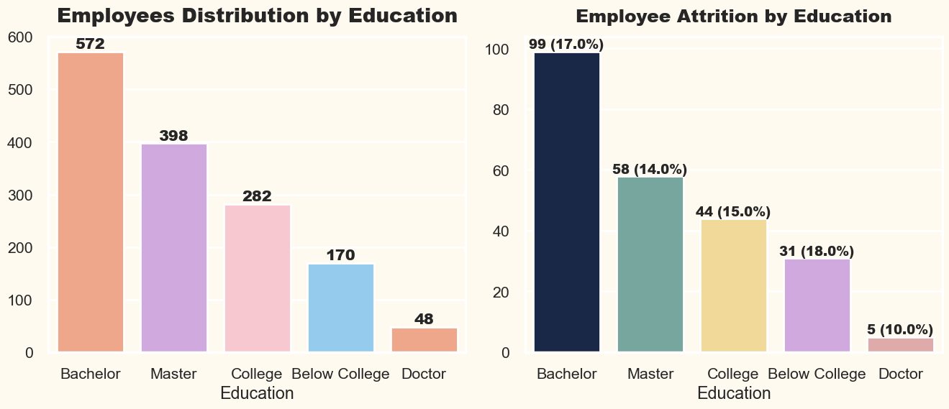
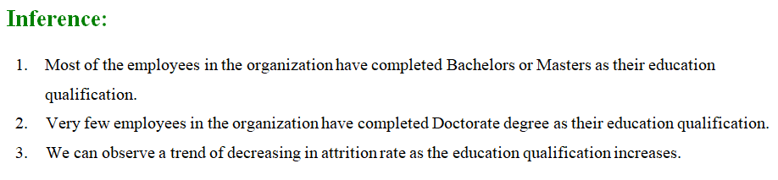

Slide 19
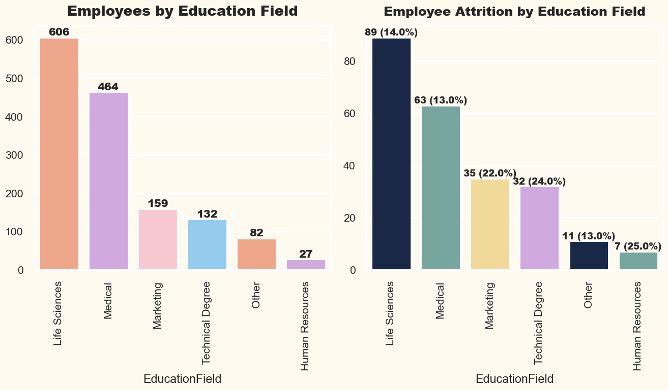
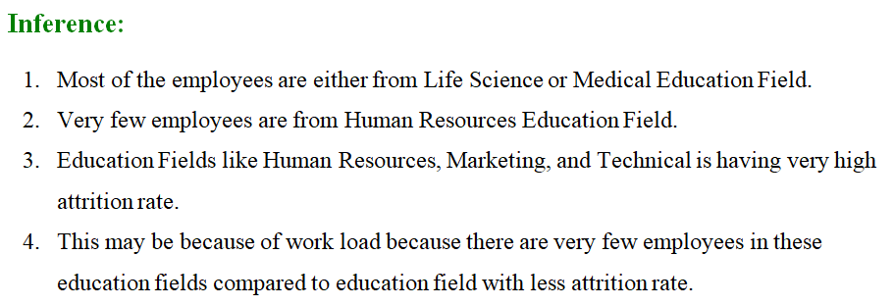
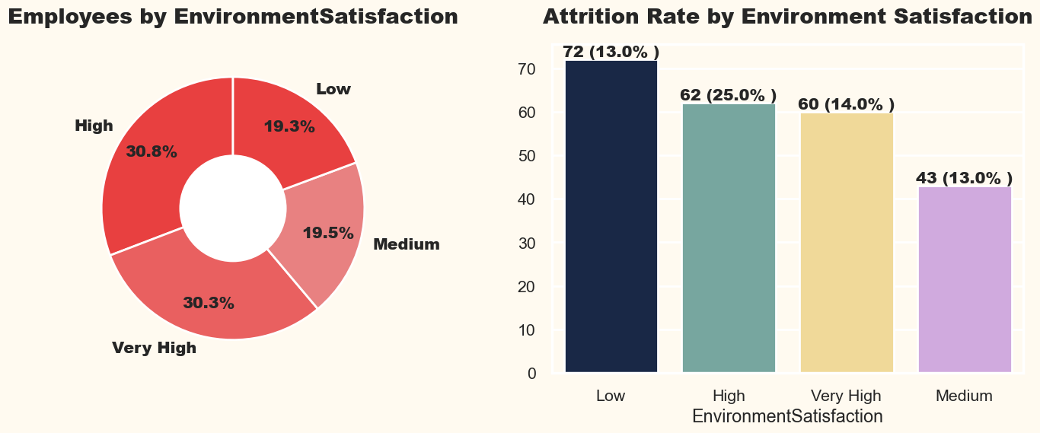
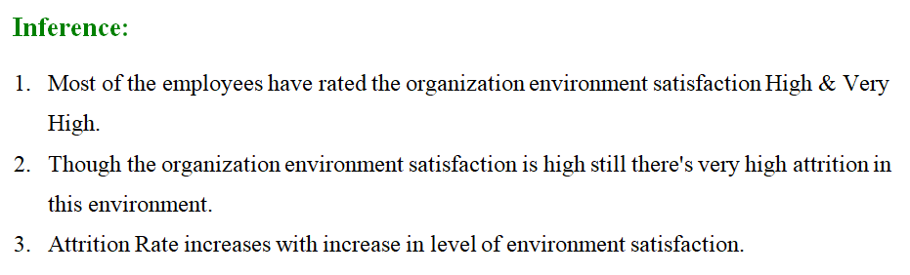

Slide 20
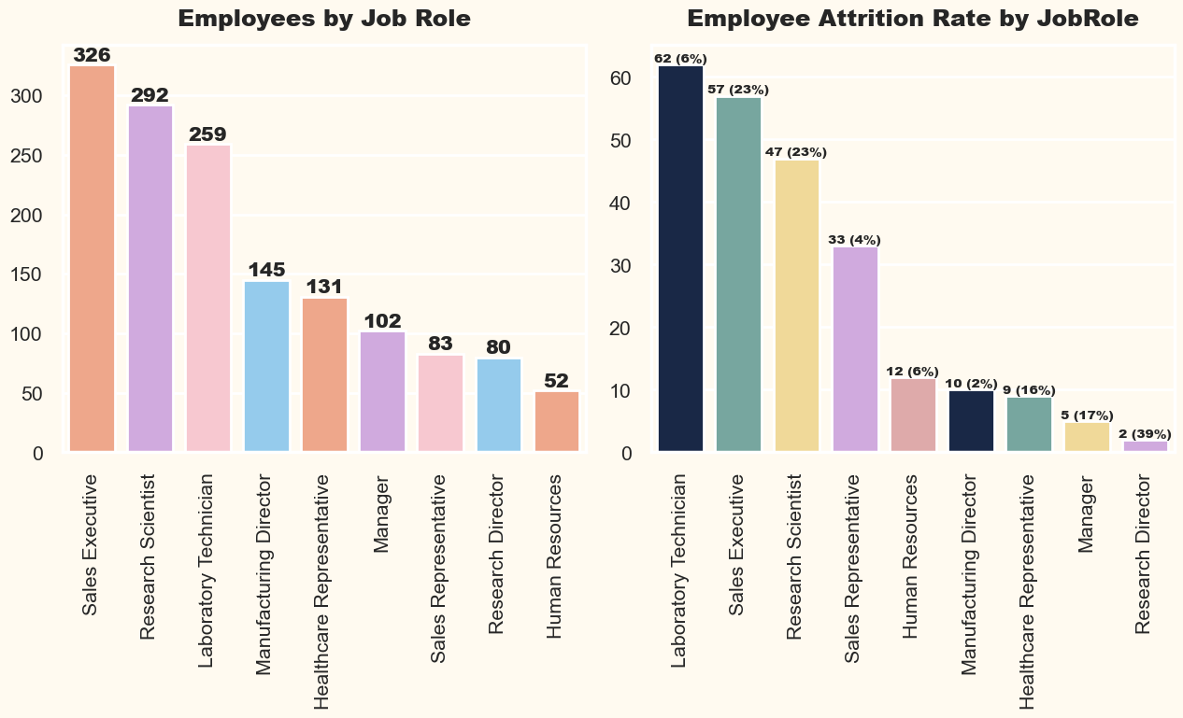
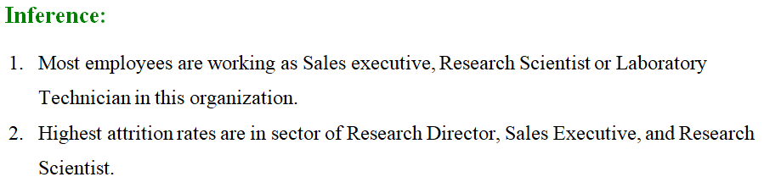
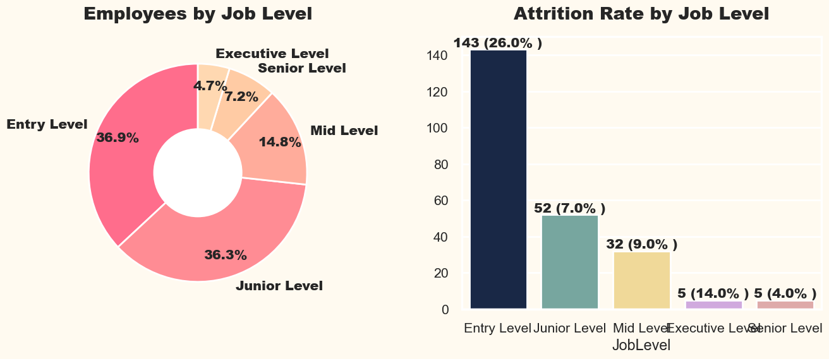
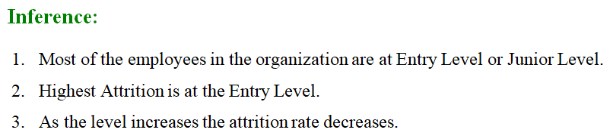

Slide 21
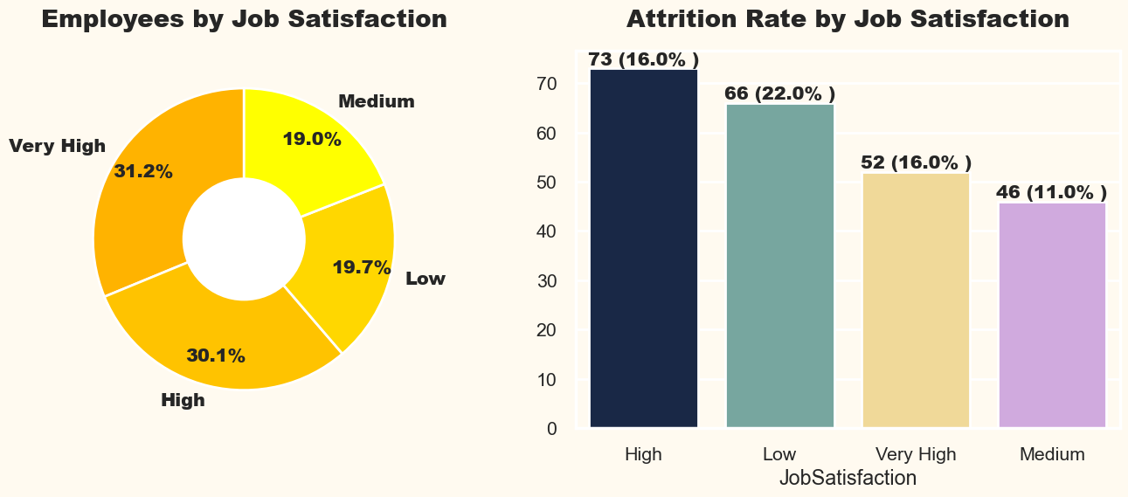
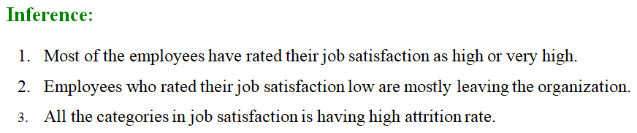
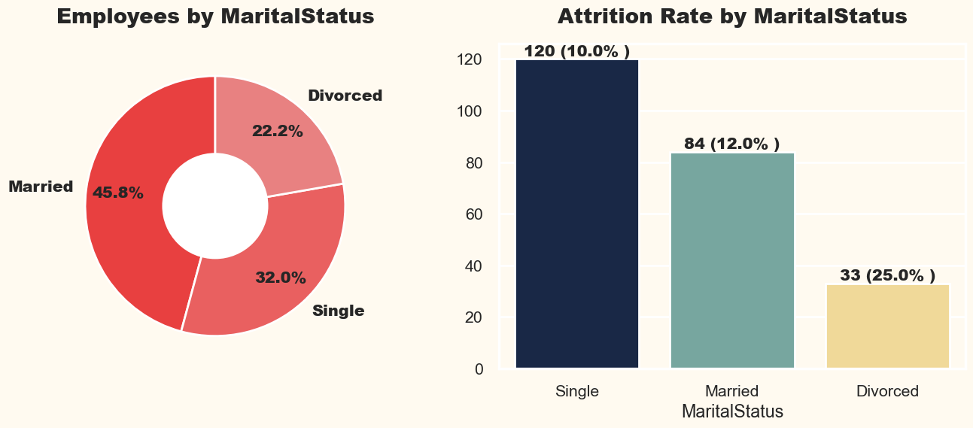
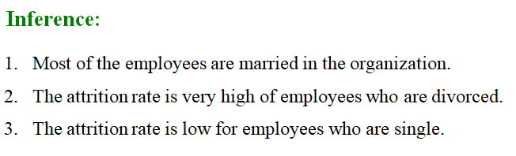

Slide 22
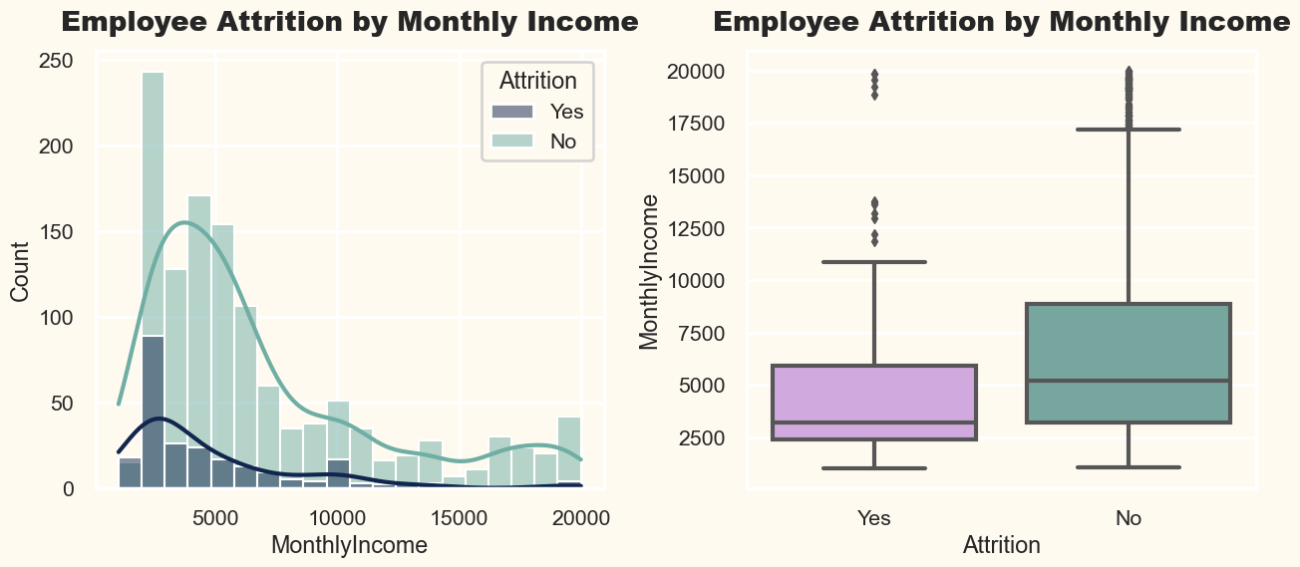
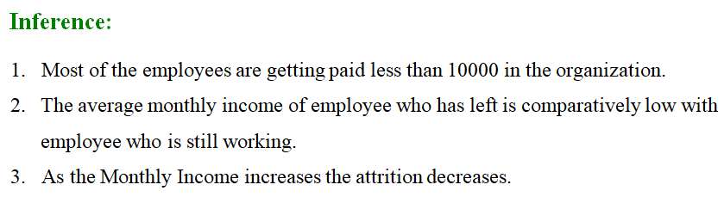
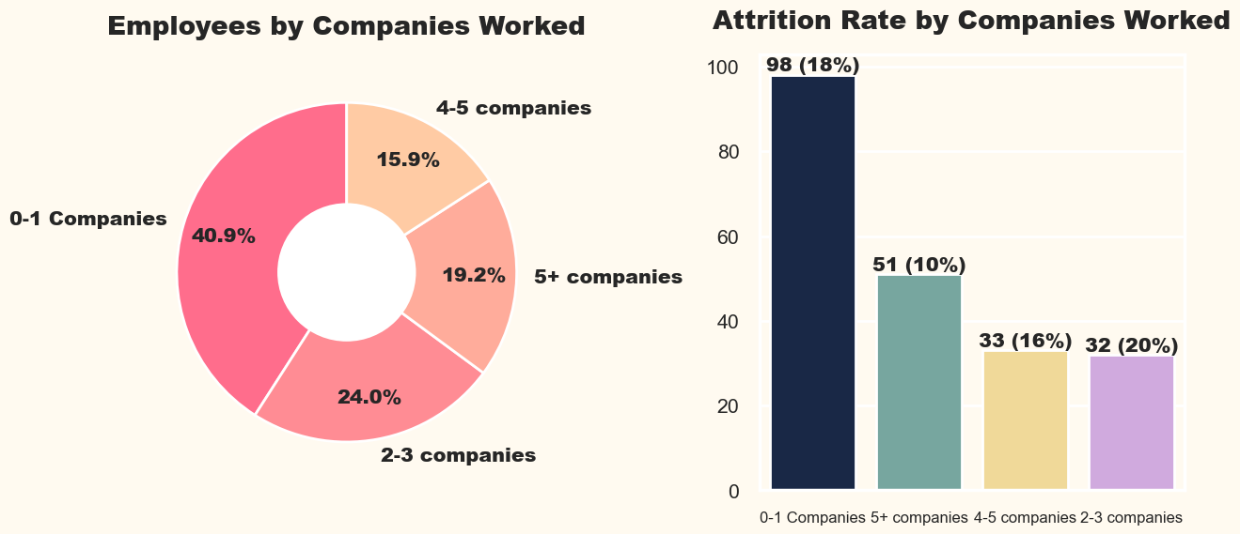
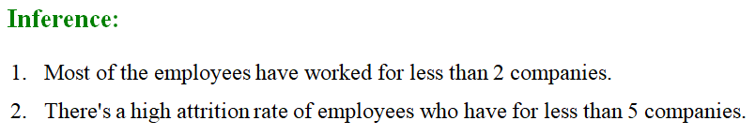

Slide 23
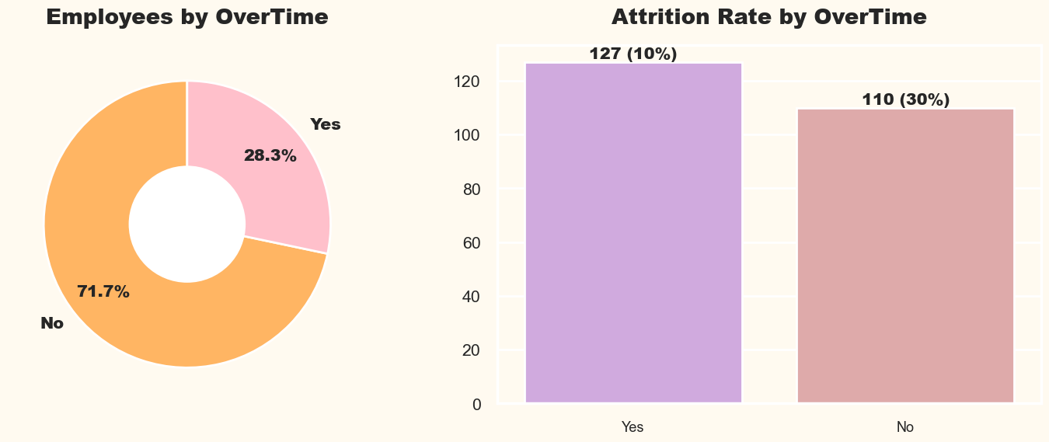
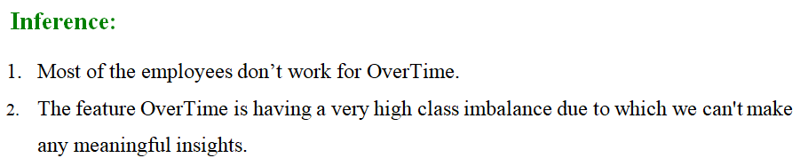
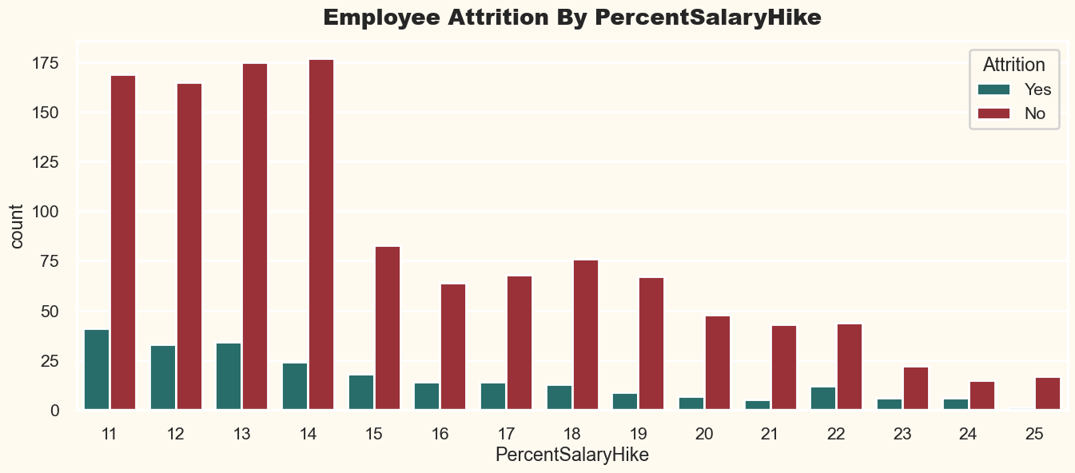
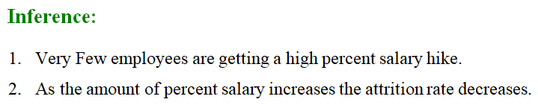

Slide 24
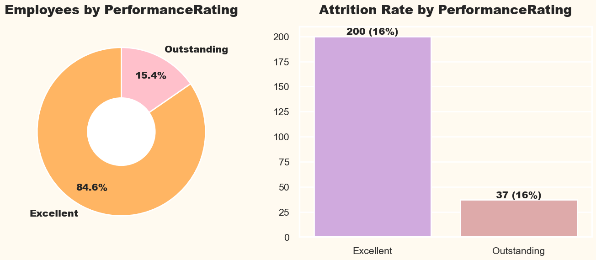
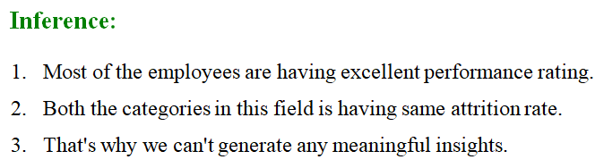
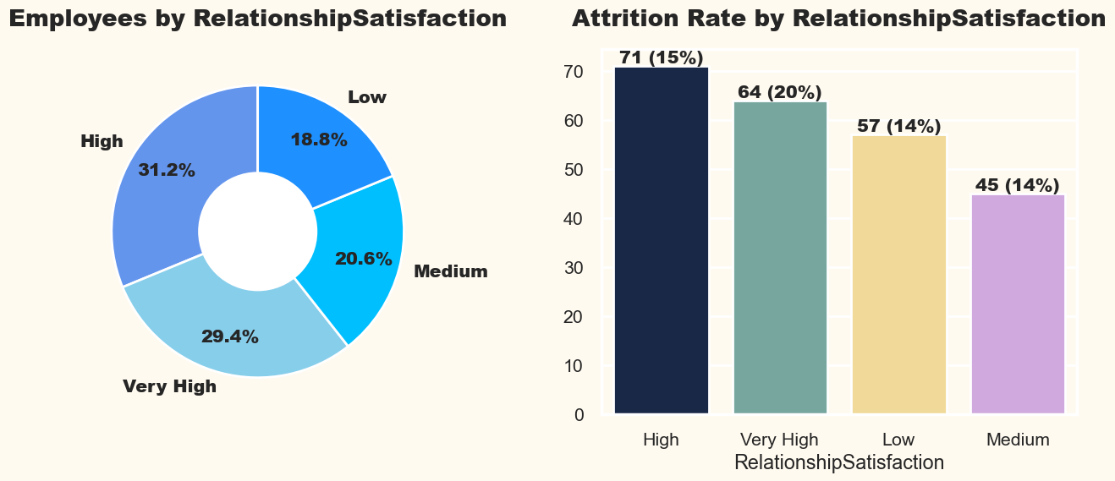
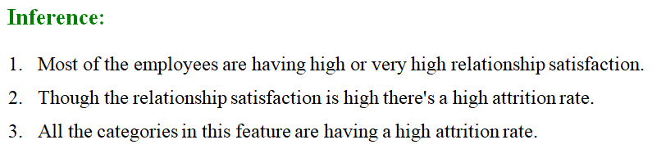

Slide 25
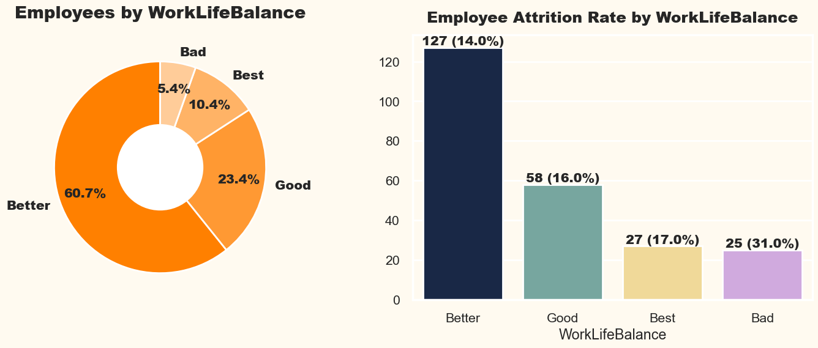
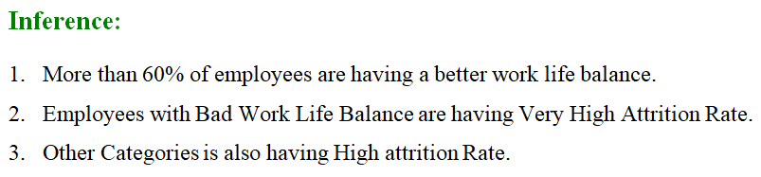
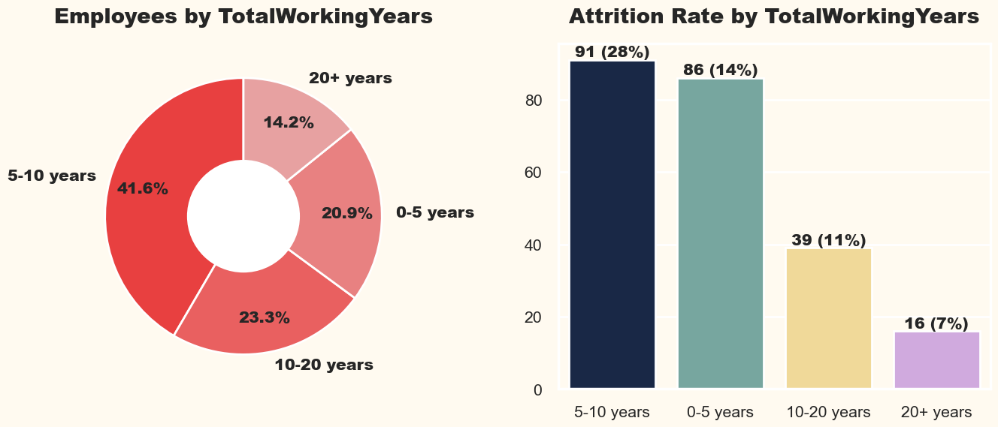
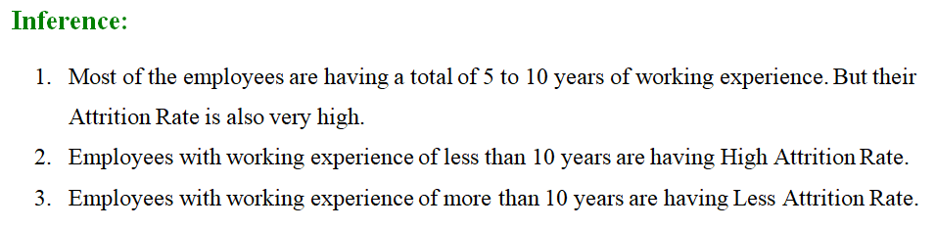

Slide 26
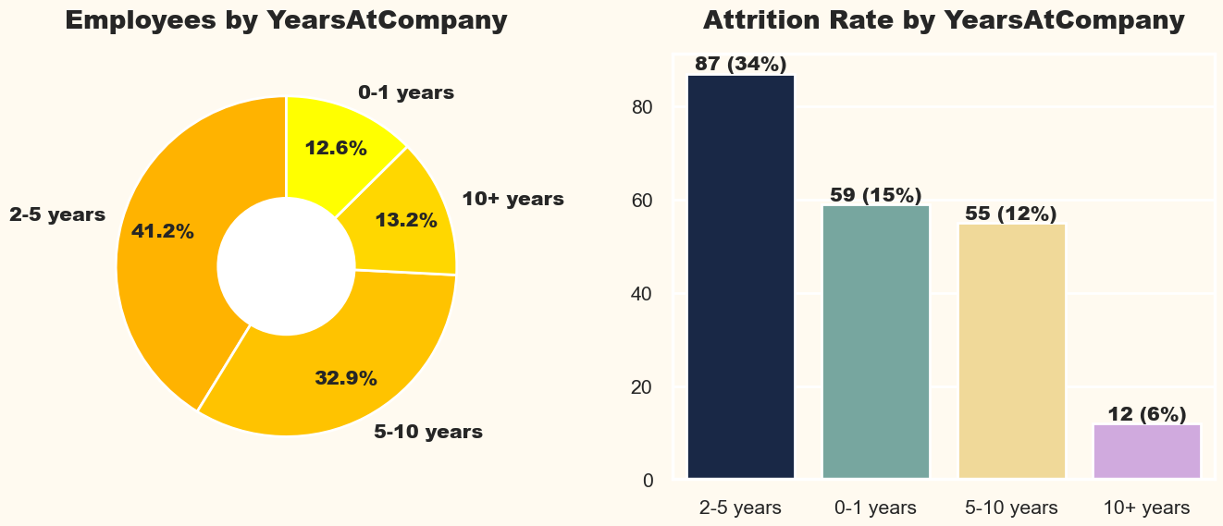




Slide 27





Slide 28


STATISTICAL ANALYSIS ANOVA TEST

Slide 29


STATISTICAL ANALYSIS CHI-SQUARE TEST

Slide 30

LABEL ENCODING

Slide 31

TRAIN AND TEST DATASET

Slide 32

LOGISTIC REGRESSION

Slide 33

RANDOM FOREST CLASSIFIER

Slide 34

SUPPORT VECTOR MACHINE

Slide 35

XGBOOST CLASSIFIER

Slide 36

ROC CURVE

Slide 37
Conclusion
In conclusion, we embarked on a comprehensive analysis of the IBM HR Analytics Attrition Dataset, from data loading to model evaluation. By implementing and evaluating various machine learning algorithms, we gained insights into which models are effective for predicting employee attrition. The results and visualizations generated throughout the process provide valuable information for decision-makers and HR professionals seeking to understand and mitigate employee attrition within the organization. This project showcases the power of data analysis and machine learning in addressing real-world business challenges.

Slide 38
References - Research Papers
- 01] Mishra S N, Lama D R and Pal Y 2016 Human Resource Predictive Analytics (HRPA) for HR Management in Organizations International Journal Of Scientific & Technology Research 5(5) 33-35
- 02] Hoffman M and Tadelis S 2018 People Management Skills, Employee Attrition, and Manager Rewards: An Empirical Analysis National Bureau of Economic Research
- 03] Frye A, Boomhower C, Smith M, Vitovsky L and Fabricant S 2018 Employee Attrition: What Makes an Employee Quit? MU Data Science Review 1(1)
- 04] S. Rabiyathul Basariya, Ramyar Rzgar Ahmed, A STUDY ON ATTRITION - TURNOVER INTENTIONS OF EMPLOYEES, International Journal of Civil Engineering and Technology (IJCIET), 2019, 10(1), PP2594-2601
- 05] Halkos, George & Bousinakis, Dimitrios, 2017. "The effect of stress and dissatisfaction on employees during crisis," Economic Analysis and Policy, Elsevier, vol. 55(C), pages 25-34.
- 06] Glavas, A., & Willness, C. (2020). Employee (dis)engagement in corporate social responsibility. In D. Haski-Leventhal, L. Roza, & S. Brammer (Eds.), Employee engagement in corporate social responsibility (pp. 10–27). Sage Publications Ltd. https://doi.org/10.4135/9781529739176.n2
- 07] S. Yadav, A. Jain and D. Singh, "Early Prediction of Employee Attrition using Data Mining Techniques," 2018 IEEE 8th International Advance Computing Conference (IACC), Greater Noida, India, 2018, pp. 349-354, doi: 10.1109/IADCC.2018.8692137.
School of Computer Engineering and Technology, MITWPU
Notes:
Paper - 7, 8, 9, 11 skip karawe lagtil.

Slide 39
References - Research Papers
- 08] R. Jain and A. Nayyar, "Predicting Employee Attrition using XGBoost Machine Learning Approach," 2018 International Conference on System Modeling & Advancement in Research Trends (SMART), Moradabad, India, 2018, pp. 113-120, doi: 10.1109/SYSMART.2018.8746940.
- 09] Alduayj, Sarah & Rajpoot, Kashif. (2018). Predicting Employee Attrition using Machine Learning. 93-98. 10.1109/INNOVATIONS.2018.8605976.
- 10] Setiawan, Irwan & Suprihanto, Suprihanto & Nugraha, Ade & Hutahaean, Jonner. (2020). HR analytics: Employee attrition analysis using logistic regression. IOP Conference Series: Materials Science and Engineering. 830. 032001. 10.1088/1757-899X/830/3/032001.
- 11] Yadav, Sandeep & Jain, Aman & Singh, Deepti. (2018). Early Prediction of Employee Attrition using Data Mining Techniques. 349-354. 10.1109/IADCC.2018.8692137.
I. Ballal, S. Kavathekar, S. Janwe, P. Shete, and N. Bhirud, “People Leaving the Job-An Approach for Prediction Using Machine Learning,” Int. J. Res. Anal. Rev., vol. 7, no. 1, pp. 8–10, 2020, [Online]. Available: www.ijrar.org
- 13] A. Qutub, A. Al-Mehmadi, M. Al-Hssan, R. Aljohani, and H.S. Alghamdi, “Prediction of Employee Attrition Using Machine Learning and Ensemble Methods,” Int. J. Mach. Learn. Comput., vol. 11, no. 2, pp. 110–114, 2021, doi:10.18178/ijmlc.2021.11.2.1022.
School of Computer Engineering and Technology, MITWPU
Notes:
Paper - 7, 8, 9, 11 skip karawe lagtil.

Slide 40
References - Research Papers
- 14] N. Mansor, N. S. Sani, and M. Aliff, “Machine Learning for Predicting Employee Attrition,” Int. J. Adv. Comput. Sci. Appl., vol. 12, no. 11, pp. 435–445, 2021, doi: 10.14569/IJACSA.2021.0121149.
- 15] D. Saisanthiya, V. M. Gayathri, and P. Supraja, “Employee Attrition Prediction Using Machine Learning and Sentiment Analysis,” Int. J. Adv. Trends Comput. Sci. Eng., vol. 9, no. 5, pp. 7550–7557, 2020, doi: 10.30534/ijatcse/2020/91952020.
School of Computer Engineering and Technology, MITWPU
Notes:
Paper - 7, 8, 9, 11 skip karawe lagtil.

Slide 41
THANKS

